Slide 1
The Plot Thickens: Tales of Survival
Unit 3
Quarter 3

Slide 2
Grammar Flip Chart
Start by grabbing 5 sheets of paper.
Wait for my instruction on how to fold your flip chart.

Slide 3
You will have 9 tabs to fill. Remember, we overlapped one tab.
Your tabs should be labeled as followed:
Parts of Speech by, your name
Interjections
Conjunctions
Verbs
Nouns
Adjectives
Adverbs
Prepositions
Pronouns

Slide 4
Under each tab you will put the following information:
Definition in your own words
Important information to help you understand
Examples sentences
Any extra info. (list of words or phrases)

Slide 5
Record & Respond to the following quotes in your ISN. THINK: What does the quote mean and how does it relate to our theme? (9 quotes total)
SKIP Card
You get one skip card. This means you should record the quote but you do not have to write your answer until we discuss it in class.

Slide 6
Discussion Protocol: Back to Back and Face to Face Purpose This protocol provides a method for sharing information and gaining multiple perspectives on a topic
Procedure
1. Find a partner and stand back-to-back with him/her. Be respectful of space.
2. Wait for the question, opinion, etc. that you will be asked to share with your partner.
3. Think about what it is you want to share and how you might best express yourself.
4. When the facilitator says, “face-to-face”, turn, face your partner, and decide who will share first if the facilitator has not
indicated that a certain person should go first.
5. Listen carefully when your partner is speaking and be sure to give him/her eye contact.
6. When given the signal, find a new partner, stand back-to-back and wait for your new questions, opinion, etc.
7. This may be repeated as many rounds as needed/appropriate.

Slide 7
“Survivors get to tell the story.” -author unknown

Slide 8
“Your fear is 100% dependent on you for its survival.” –Steve Maraboli, Life, the Truth, and Being Free

Slide 9
“Survivors aren’t always the strongest; sometimes they’re the smartest, but more often simply the luckiest.” -Carrie Ryan, The Dark and Hollow Places

Slide 10
“If one reads enough books one has a fighting chance. Or better, one’s chances of survival increase with each book one reads.” -Sherman Alexie

Slide 11
“Sometimes the greatest tests of our strength are situations that don’t seem so obviously dangerous. Sometimes surviving is the hardest thing of all.” -Richelle Mead, Last Sacrifice

Slide 12
“Extinction is the rule., Survival is the exception.” -Carl Sagan, The Varieties of Scientific Experience: A Personal View of the Search for God

Slide 13
“The strong survive, but the courageous triumph.” -Michael Scott, The Warlock

Slide 14
“It is not the strongest or the most intelligent who will survive but those who can best manage change.” -Charles Darwin

Slide 15
“A scar does not form on the dying. A scar means, I survived.” -Chris Cleave, Little Bee

Slide 16
Guiding Questions for this unit:
What does it take to be a survivor?
What causes people to take risks?
What makes some take risks and others not?
What are some unexpected outcomes of being a survivor?

Slide 17
Mood Tone Explicit Details Implicit Details

Slide 18
Warm Up: Read the items below.
Poetry slam this Friday—make sure your poem is finished
Mock EOG scores were ☺ (3 people need to take it)
Take out a piece of paper for interactive notes today.
Respond to the following: What is integrity?

Slide 19
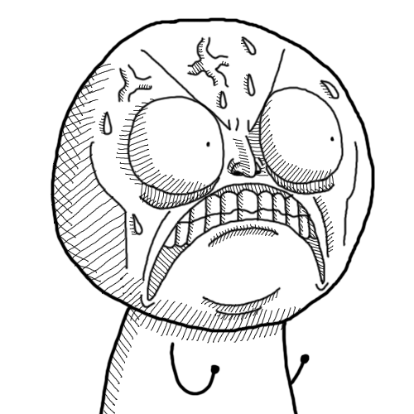
WHAT ARE YOU DOING?!
The key idea being that an author's tone can affect your mood.
How did my TONE affect your MOOD?
Quick Tip: Record this example in your ISN, so you’ll never forget how TONE affects MOOD!
Notes:
Curry’s Reminders: Slam hands on my desk and yell “What are you DOING?” to the entire class. Wait a few seconds, let them freak out. Then ask them in a kind voice and a smile on my face “How did my TONE affect your MOOD?” Great example for how an author’s tone affects the reader’s mood. Students should already know tone and mood at this point. Ask a few students to review the definitions, in case some have forgotten.

Slide 20
Record the important info.
TONE:
The author’s attitude, stated or implied, toward a subject.
Some possible attitudes are pessimism, optimism, earnestness, seriousness, bitterness, humorous, and joyful.
An author’s tone can be revealed through choice of words and details.
MOOD:
The climate of feeling in a literary work.
The choice of setting, objects, details, images, and words all contribute toward creating a specific mood.
For example, an author may create a mood of mystery around a character or setting but may treat that character or setting in an ironic, serious, or humorous tone.

Slide 21
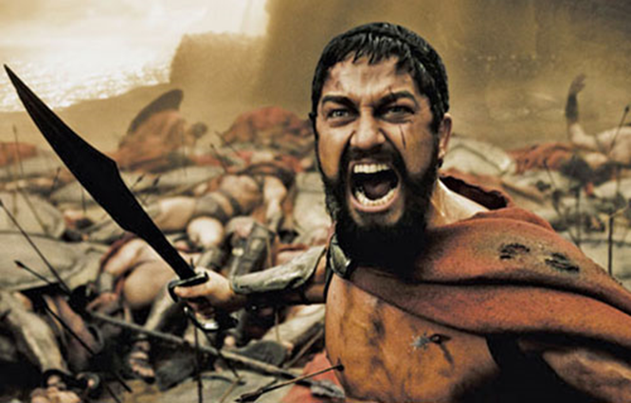
This is a Spartan King. Based on the tone of this image, what mood are you in?

Slide 22
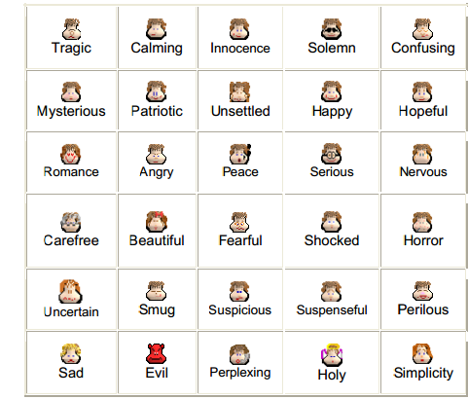
There are countless MOODS created in literature, but here are a few:

Slide 23
If you consider yourself to be athletic please stand up.
Implicit Details
I have a feeling you are skilled at basketball.
Explicit Details
Evidence to support this statement:

Slide 24
What attributes do the explicit details share that contrasts them from the implicit detail?
Implicit Details
I have a feeling you are skilled at basketball.
Explicit Details
Evidence to support this statement:
He is wearing basketball shorts.
He is tall.
He is wearing basketball shoes.
A detail we can’t really see, a vague detail
more specific detail, details we can see, measurable details

Slide 25
Expert Definition—record this in your ISN
Implicit details
Explicit details
implied though not plainly expressed from The Oxford Dictionary
stated clearly and in detail, leaving no room for confusion or doubt from The Oxford Dictionary

Slide 26
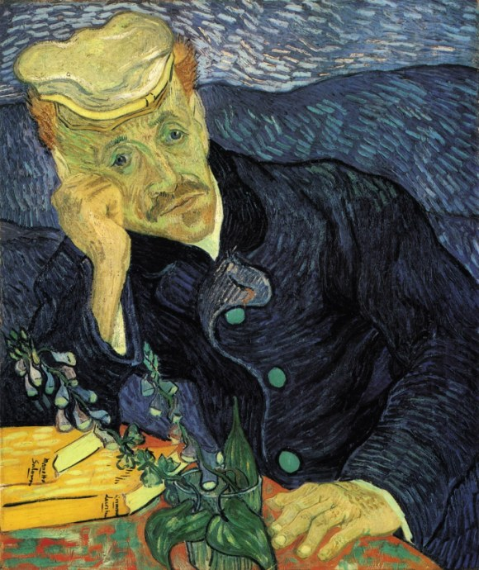
Portrait of Dr. Gachet, Vincent Van Gogh, 1890
Notes:
Curry’s Reminders: Students observe the portrait and interpret how Dr. Gachet is feeling. His feeling, or the tone of the piece, is an implicit detail, the evidence to support that thinking are the explicit details. The students often say that Dr. Gachet is sad. The tone of the portrait is sadness. That is an implicit detail, the students have inferred or interpreted that he is feeling sad based on their observations. Then the students have to find the explicit evidence to prove that he is sad: his frown, the dark colors, the hand on his face, his droopy eyes.
When students are finished they can begin to compose or create a short paragraph to describe the tone of the painting. The implicit detail is the topic sentence. The explicit details are the supporting sentences. Very structured, well-thought out and meets the goals of our state learning objectives. But with my students I wanted to continue to go deeper with the idea and to also show them that a well written paragraph is not always the end all be all of our class.

Slide 27
What is the man’s mood?
Portrait of Dr. Gachet, Vincent Van Gogh, 1890
Notes:
Curry’s Reminders: Students observe the portrait and interpret how Dr. Gachet is feeling. His feeling, or the tone of the piece, is an implicit detail, the evidence to support that thinking are the explicit details. The students often say that Dr. Gachet is sad. The tone of the portrait is sadness. That is an implicit detail, the students have inferred or interpreted that he is feeling sad based on their observations. Then the students have to find the explicit evidence to prove that he is sad: his frown, the dark colors, the hand on his face, his droopy eyes.
When students are finished they can begin to compose or create a short paragraph to describe the tone of the painting. The implicit detail is the topic sentence. The explicit details are the supporting sentences. Very structured, well-thought out and meets the goals of our state learning objectives. But with my students I wanted to continue to go deeper with the idea and to also show them that a well written paragraph is not always the end all be all of our class.

Slide 28
Implicit Details:
What is the man’s mood?
He’s sad
He’s unhappy
He’s distraught!
Portrait of Dr. Gachet, Vincent Van Gogh, 1890
Notes:
Curry’s Reminders: Students observe the portrait and interpret how Dr. Gachet is feeling. His feeling, or the tone of the piece, is an implicit detail, the evidence to support that thinking are the explicit details. The students often say that Dr. Gachet is sad. The tone of the portrait is sadness. That is an implicit detail, the students have inferred or interpreted that he is feeling sad based on their observations. Then the students have to find the explicit evidence to prove that he is sad: his frown, the dark colors, the hand on his face, his droopy eyes.
When students are finished they can begin to compose or create a short paragraph to describe the tone of the painting. The implicit detail is the topic sentence. The explicit details are the supporting sentences. Very structured, well-thought out and meets the goals of our state learning objectives. But with my students I wanted to continue to go deeper with the idea and to also show them that a well written paragraph is not always the end all be all of our class.

Slide 29
Give me explicit details to prove your point. Remember explicit details are ones that are on the surface or we can “point” to.
Portrait of Dr. Gachet, Vincent Van Gogh, 1890
Notes:
Curry’s Reminders: Students observe the portrait and interpret how Dr. Gachet is feeling. His feeling, or the tone of the piece, is an implicit detail, the evidence to support that thinking are the explicit details. The students often say that Dr. Gachet is sad. The tone of the portrait is sadness. That is an implicit detail, the students have inferred or interpreted that he is feeling sad based on their observations. Then the students have to find the explicit evidence to prove that he is sad: his frown, the dark colors, the hand on his face, his droopy eyes.
When students are finished they can begin to compose or create a short paragraph to describe the tone of the painting. The implicit detail is the topic sentence. The explicit details are the supporting sentences. Very structured, well-thought out and meets the goals of our state learning objectives. But with my students I wanted to continue to go deeper with the idea and to also show them that a well written paragraph is not always the end all be all of our class.

Slide 30
Explicit Details:
His eyes are sloping down.
His head is resting on his hand.
The picture is blue.
The man is frowning.
Portrait of Dr. Gachet, Vincent Van Gogh, 1890
Notes:
Curry’s Reminders: Students observe the portrait and interpret how Dr. Gachet is feeling. His feeling, or the tone of the piece, is an implicit detail, the evidence to support that thinking are the explicit details. The students often say that Dr. Gachet is sad. The tone of the portrait is sadness. That is an implicit detail, the students have inferred or interpreted that he is feeling sad based on their observations. Then the students have to find the explicit evidence to prove that he is sad: his frown, the dark colors, the hand on his face, his droopy eyes.
When students are finished they can begin to compose or create a short paragraph to describe the tone of the painting. The implicit detail is the topic sentence. The explicit details are the supporting sentences. Very structured, well-thought out and meets the goals of our state learning objectives. But with my students I wanted to continue to go deeper with the idea and to also show them that a well written paragraph is not always the end all be all of our class.

Slide 31
Now, you are going to turn these details into a well written paragraph.
The implicit detail becomes the topic sentence.
Next the explicit details prove the topic is true.
Dr. Gachet is a distraught man. Van Gogh shows this through Dr. Gachet’s frown. The downward slope of his eyes also demonstrates sadness. Finally, Dr. Gachet is resting his head in his hand in a way that confirms his unhappiness.

Slide 32
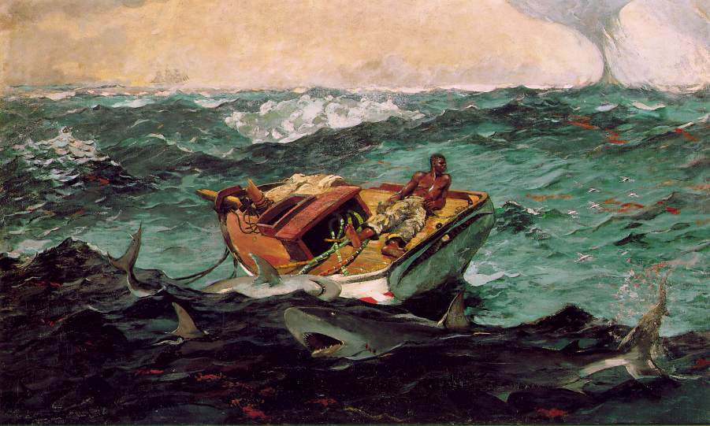
What is the man’s mood?
The Gulf Stream, Winslow Homer, 1899, oil

Slide 33
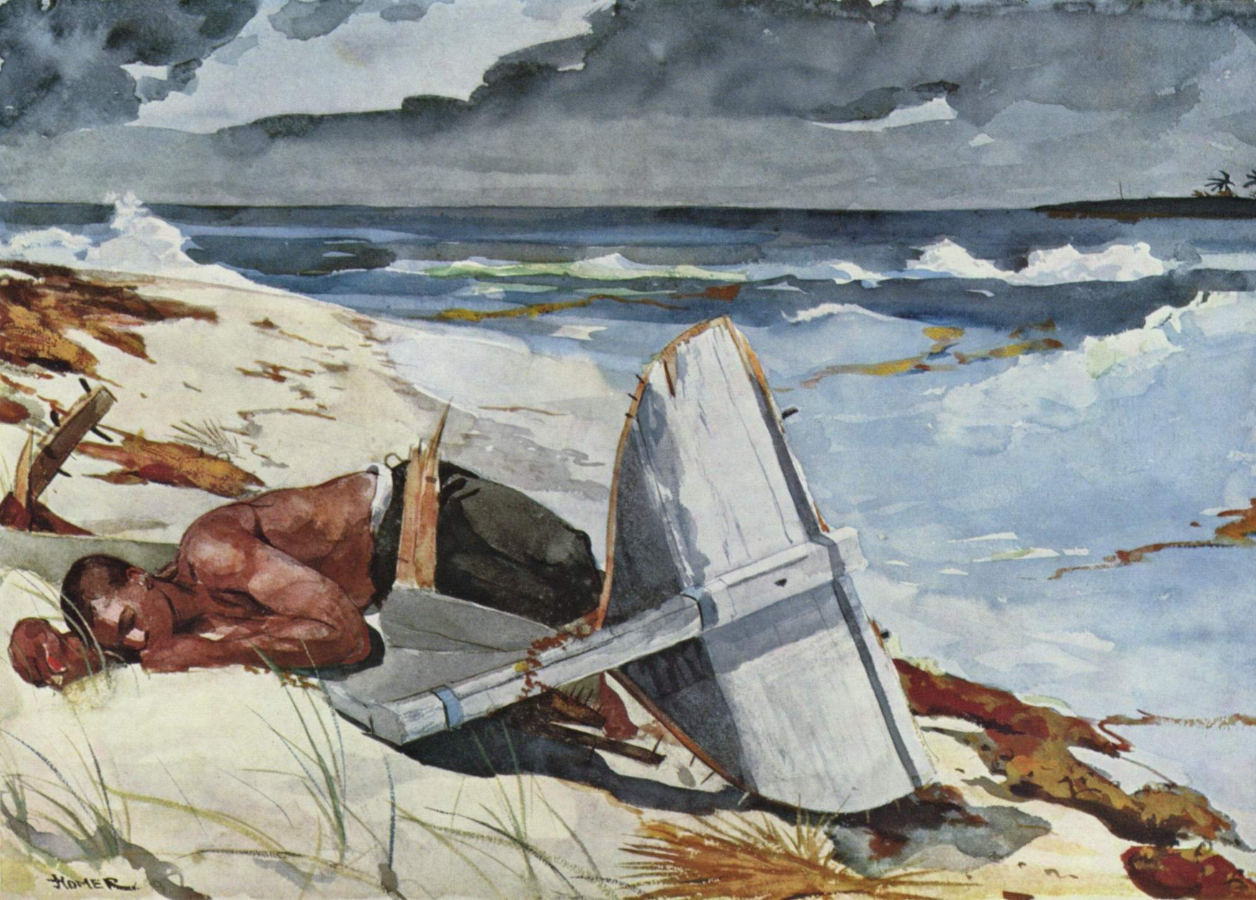
What is the man’s mood?
After the Hurricane, Winslow Homer, 1899

Slide 34
Limbo http://youtu.be/Y4HSyVXKYz8
Implicit Details
Explicit Details

Slide 35
Paragraph—Remember implicit is the topic sentence and explicit is the supporting sentences

Slide 36
Little Big Planet 2 http://youtu.be/Ky-JUL0SDDs
Implicit Details
Explicit Details

Slide 37
Paragraph—Remember implicit is the topic sentence and explicit is the supporting sentences

Slide 38
http://www.wingclips.com/movie-clips/jaws/a-bigger-boat
Implicit Details
Explicit Details

Slide 39
http://www.wingclips.com/movie-clips/fireproof/train-rescue
Implicit Details
Explicit Details

Slide 40
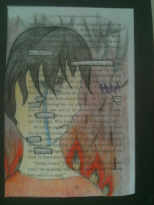
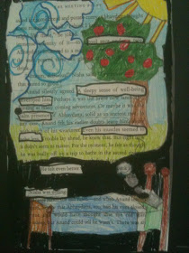
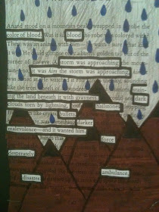
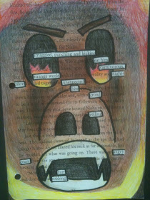
To be continued…
Using the poems in this unit or other excerpts have students create one of these after identifying the tone, mood, implicit/explicit details
Notes:
http://www.byrdseed.com/differentiating-comprehension-skills-noting-details/
http://www.creativity2point0.org/2012/10/tone-and-mood-in-literature-moving.html?m=1

Slide 41
Whoa 20-footer (20-fer) boat was creaking splashes from the shark “we’re gonna need a bigger boat”
The video clip from Jaws, made me feel frightened. The giant sharks makes the viewer feel frightened. The music was foreshadowing that something was about to happen, which added to my fear. The characters from the clip were in the middle of the ocean, on a small boat and one of the characters shouted “We are going to need a bigger boat!” The blood in the ocean added a sense of fear to the clip and helped solidify the way I felt.

