Slide 1
The Great Debate: Resources to Build Your Argument
Who was responsible for the sinking of the Titanic?
o Captain John Edward Smith
o Joseph Bruce Ismay
o The Moon
o Another Theory

Slide 2
Argumentative Writing
When you write an argument, you are presenting one side of a view. In an argument you should…
-State your claim strongly
-Support your claim with evidence (FEED CATS)
-Maintain an equal balance of ethos, logos, and pathos to connect with your audience and get your message across clearly.
-Follow the rubric and outline provided
-This is a general video about a full essay. Remember, ours is a “mini-essay”
http://video.about.com/homeworktips/How-to-Write-an-Argument-Essay.htm

Slide 3
General Resources to Build FEED CATS Exploring Argument Via Media
Original newsreel footage shown to the public in 1912 regarding the Titanic disaster
https://www.youtube.com/watch?v=FC9e5LTaKbI
2012 Animation of the Sinking of Titanic http://www.youtube.com/watch?v=cnuHD3sme2s
Was One Person Responsible?https://www.youtube.com/watch?v=-hhSJMmnUec
Who is to blame?https://www.youtube.com/watch?v=ywU3cahF9Uc

Slide 4
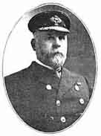
Captain Edward John Smith
Read Titanic Captain Blamed for Wreck
http://www.sfmuseum.net/hist6/carpathia.html
Watch Titanic Artifact Exhibition Captain Edward J Smith http://www.youtube.com/watch?v=AaLYk0EBibE
http://www.bbc.co.uk/history/british/britain_wwone/titanic_01.shtml

Slide 5
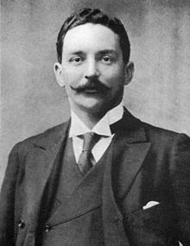
English Businessman Bruce Ismay
Read this article: Joseph Bruce Ismay (read pages 2-3)
Watch Titanic’s Bruce Ismay: From Disaster to Irish Refuge http://www.youtube.com/watch?v=tOEeRXhMHyE
Mr. Ismay Regrets?
https://www.youtube.com/watch?v=G0MK_s_XlwI
http://en.wikipedia.org/wiki/J._Bruce_Ismay

Slide 6
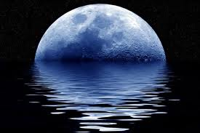
The Moon
Read Moon to Blame for Titanic Sinking http://www.socialstudiesforkids.com/articles/currentevents/titanicmoon.htm
Read: Titanic Sunk By Supermoon
http://news.nationalgeographic.com/news/2012/03/120306-titanic-supermoon-moon-science-iceberg-sky-sink/
Watch Was it the Moon? http://www.youtube.com/watch?v=Ya0zez53KVM
http://www.space.com/15455-blue-moon.html

Slide 7
Extra Resources to Build Your FEED CATS
http://historyonthenet.com/Titanic/passengers.htm
http://www.encyclopedia-titanica.org/titanic-survivor/ruth-elizabeth-becker.html
Video clip on survivors of the Titanic with Ruth Becker http://www.youtube.com/watch?v=lywYIF2EdOY
http://www.youtube.com/watch?v=lywYIF2EdOY

Slide 8
Extra Resources to Build Your FEED CATS
http://topics.nytimes.com/top/reference/timestopics/subjects/t/titanic/index.html
http://education.nationalgeographic.com/education/media/sinking-of-the-titanic/?ar_a=2
http://www.scientificamerican.com/article.cfm?id=titanic-safety-rescue
http://www.agcs.allianz.com/assets/PDFs/Reports/AGCS_Safety_and_Shipping_Executive_Summary.pdf

